Slide 1
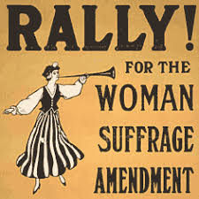
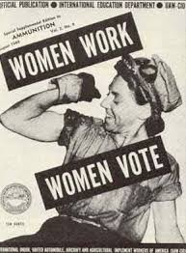
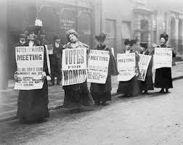
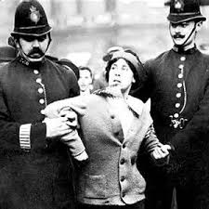
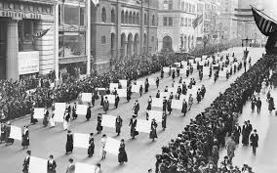
Women’s Rights

Slide 2
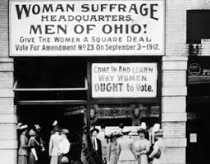
Helpful Vocab:
Suffrage: the right to vote
Suffragist: someone who wants to extend the right to vote
Abridge: to deprive or limit

Slide 3
Why couldn’t women vote?
Originally the US Constitution didn’t say much about who had the right to vote. The country’s framers left it up to the states to decide. Most state initially limited voting rights to white male property owners. Over time they extended voting rights to nearly all white men. After the Civil War, three amendments were added to the Constitution. These additions at the federal level freed the slaves, made them citizens, and granted them voting rights. The 14th amendment, ratified in 1868, specifically identified “voters” as male. It was the first time a federal document had done so.

Slide 4
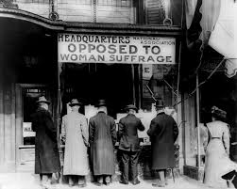
Why were women excluded, both from many individual states’ laws and from the 14th amendment? The framers of the Constitution-- and many who followed them for more than the next 100 years– believed that women were childlike and incapable of independent though. They believed that women could not be counted on to vote responsibly, so they left women out of states’ voting laws and the Constitutional amendments that granted voting rights to African American men.
As early as the 1840s, some
women began speaking out,
arguing that women should
have the right to vote, It took until
1920 for that right to be
added to the US Constitution.

Slide 5
Complete pages 1-3 in Women’s Rights packet

Slide 6
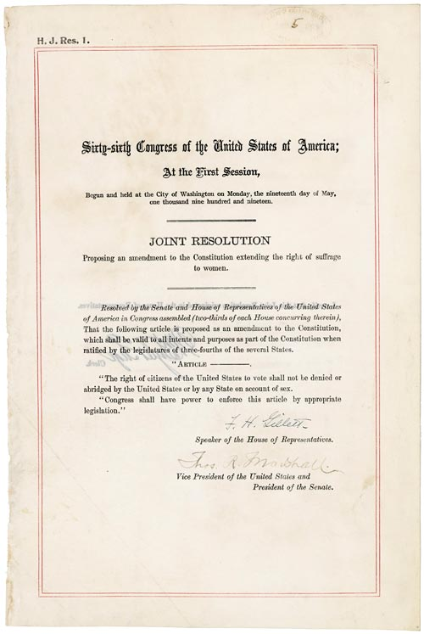
19th Amendment
The right of citizens of the United States to vote shall not be denied or abridged by the United States or by any State on account of sex.
Congress shall have power to enforce this article by appropriate legislation.

Slide 7
How did women try and get the right to vote?
VIDEO

Slide 8
Moral Persuasion
In the 1800s, many Americans thought that men and women were completely different from each other. They thought that men were intellectual and women were emotional. They thought that men were worldly and women were spiritual. They thought that men belonged out in public and women belonged in the home. They believed that men were corrupt and women were morally pure.
Large numbers of women who held these beliefs wanted the right to vote. How would women make the case that they should be able to vote?

Slide 10
Constitutional Amendment
Many women wanted women to have the right to vote because they believed that women were men’s equals. At the Seneca Falls Convention in 1848, these women wrote a Declaration of Sentiments that said that “all men and women are created equal.” During Woodrow Wilson’s presidency, these women protested publicly. They even picketed at the White House, which was both illegal and considered terribly unladylike. These suffragists believed that the federal government had to grant women the right to vote, the same way it granted freed black men the right to vote after the Civil War.
VIDEO

Slide 11
State-by-State
Many women wanted to secure women’s right to vote one state at a time. They believed that would be the most successful strategy to get votes for women. These women achieved some success. Fifteen states and the territory of Alaska had full voting rights for women by the time the 19th Amendment was ratified in 1920. At the state-by-state level, women used a variety of arguments to make their case.

Slide 13
Do you think women would have gotten the right to vote if there wasn’t an amendment?

Slide 14
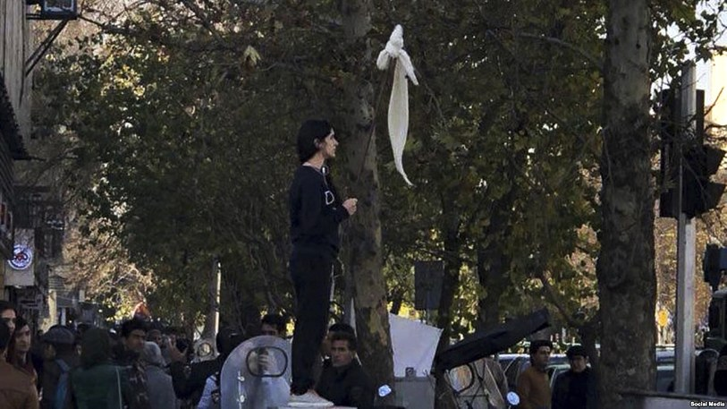
Vida Movahed, pictured lifting her head scarf into the air on Tehran’s Enghelab Street, is credited with sparking a wave of protests in Iran again the compulsory wearing of the hijab.
Women’s Rights Today?

