Slide 1
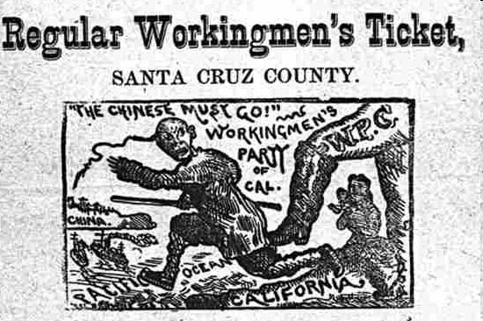
- According to the cartoonist, how do the workingmen of California feel?
- In your opinion, why do the workingmen feel this way?

Slide 2
- According to the cartoonist, how do the workingmen of California feel?
They want Chinese workers to be sent back to China.
- In your opinion, why do the workingmen feel this way?
Americans in California were competing with Chinese immigrants for jobs. Many Americans resented the Chinese since they were willing to accept lower salaries than Americans were.

Slide 3
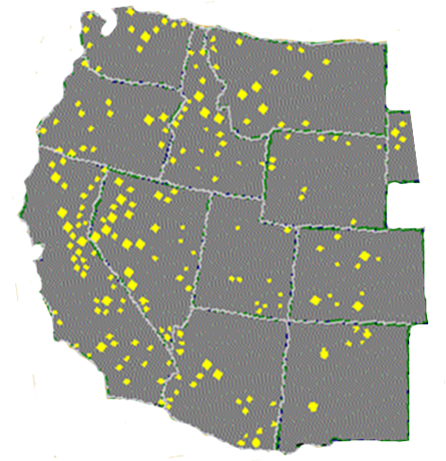
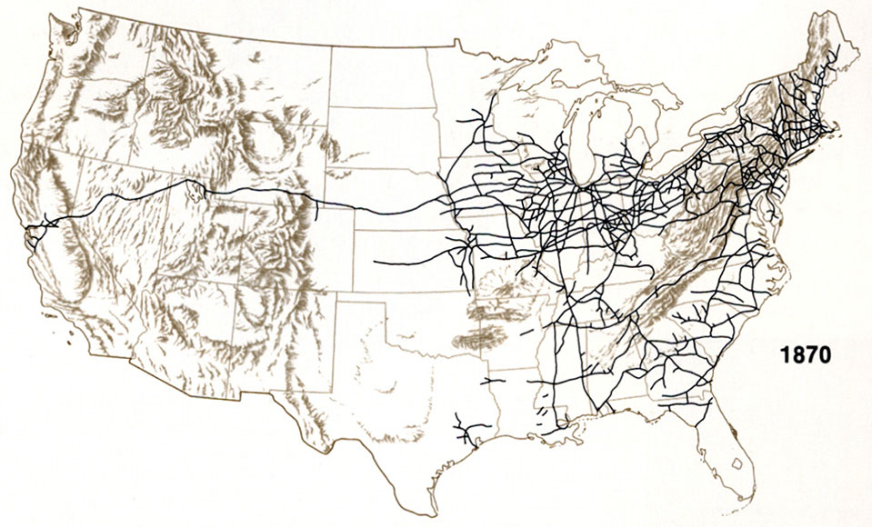
The Transcontinental Railroad
· Railroad companies raced to lay tracks to the mines in order to supply the miners.
J
j

Slide 4
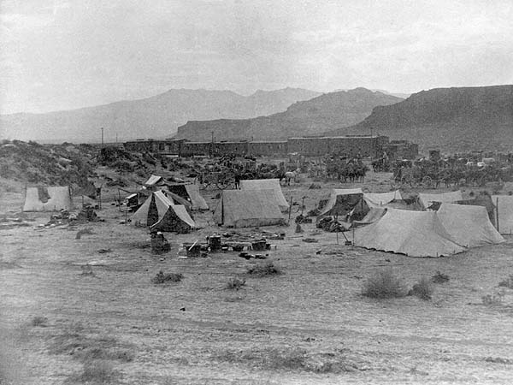
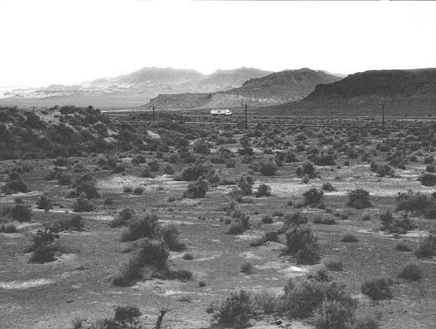
Images courtesy of Lawrence K. Hersh, Publisher, “Central Pacific Railroad Across Nevada”
May of 1997; it appears as if the freight trail can still be seen
"End of Track, near Humboldt Lake," circa 1868, showing a construction train stopped, headed eastbound, with lots of tents in the foreground. These tents were probably occupied by Chinese laborers.

Slide 5
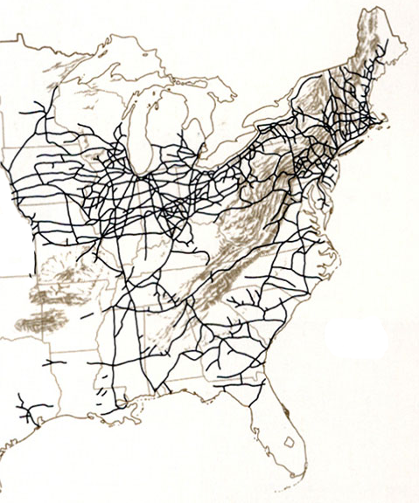
Promontory Point, Utah
Omaha, Nebraska
.
.
Union Pacific Railroad
x
Central Pacific Railroad
J
j
Sacramento, California
· In 1863, two companies, the Union Pacific and the Central Pacific, began building the first transcontinental railroad.

Slide 6
“White manpower, the kind employers preferred, was in desperately short supply, diverted by the call to arms or the shout of “Eureka!” in the goldfields. The few white recruits who did straggle in…leaned on their picks when the boss rode away and shouldered their shovels on payday.”
Immigrant Workers
· Labor was scarce due to the hard, dangerous work and low pay.
Union Pacific - hired many Irish immigrants
Central Pacific - approximately 90% of their workforce were Chinese immigrants
· Therefore, immigrant labor was used.

Slide 7
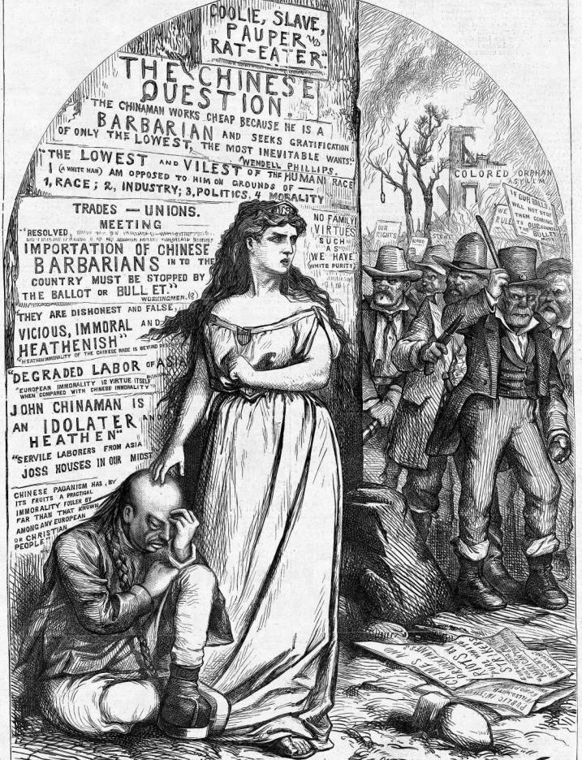
“The Central Pacific management even considered importing 5,000 Rebel prisoners (the Civil War’s end foiled the plan) and peons from Mexico (rejected as too lazy). Diligent beyond a doubt were some 40,000 Chinese already in California. But “rice eating weaklings”?
"The Chinese Question" Harper’s Weekly, February 18, 1871
by, Thomas Nast

Slide 8
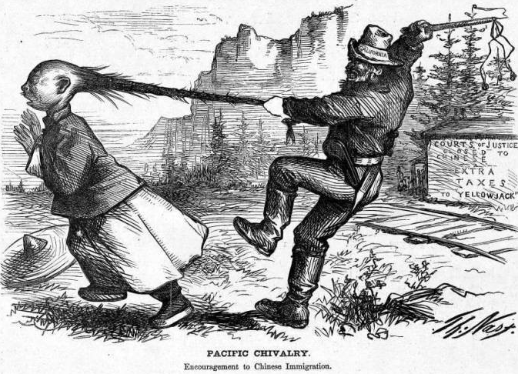
“PACIFIC CHIVALRY” Harper’s Weekly, August 7, 1869, page 512 (Nast Cartoon)

Slide 9
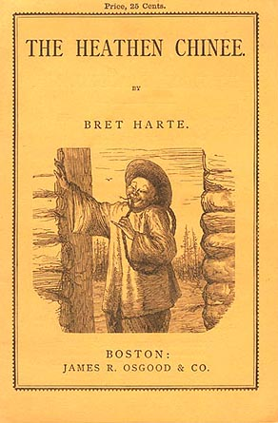
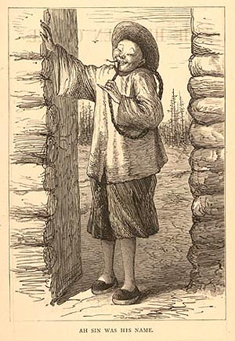
1871

Slide 10
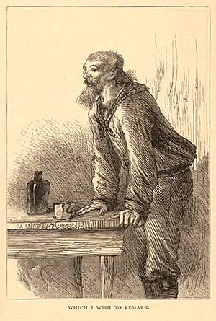
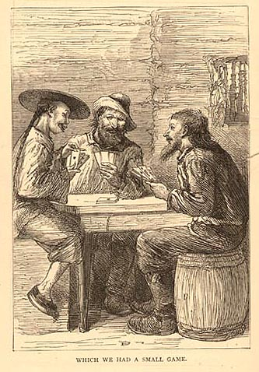

Slide 11
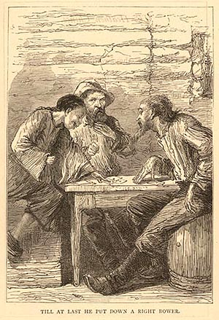
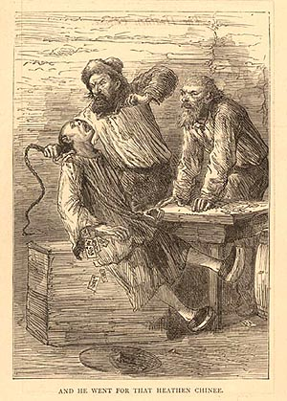

Slide 12
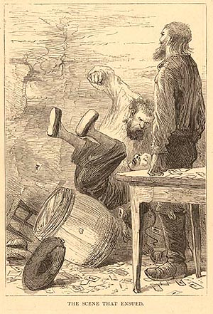
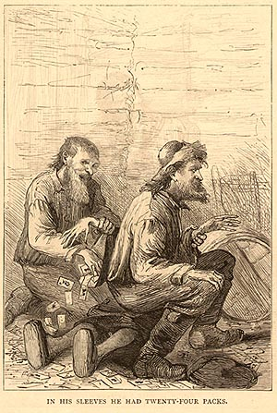

Slide 13
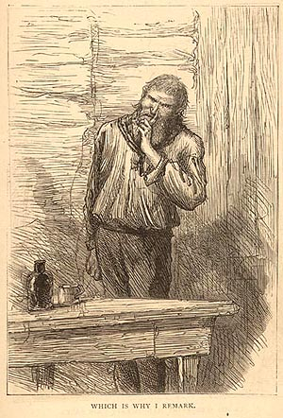

Slide 14
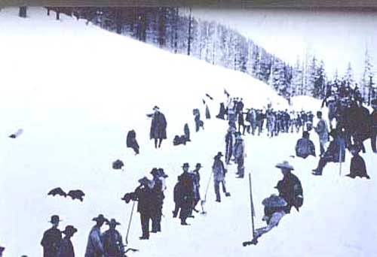
· The workers endured scorching deserts, blinding snowstorms, and blasted through mountains.
Chinese railroad workers perform their duties in the snow.

Slide 15
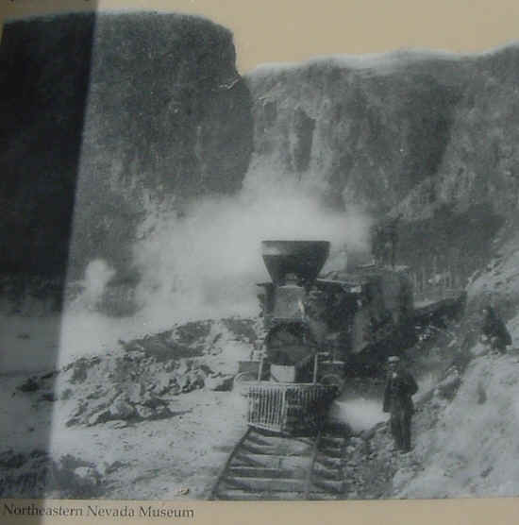

Slide 16
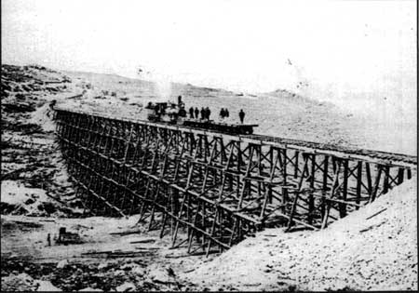
The Big Trestle, the last major bridge of the transcontinental railroad, close to Promontory, Utah.

Slide 17
“This ‘cape’ was a wall of rock 2,700 feet high, rising steeply from the American River and largely innocent of even a toehold. But the Chinese wove large wicker baskets, marked them with bright symbols to ward off evil spirits, and at the sound of the sunrise whistle marched silently off to the ridgetop. From one end of their bamboo carrying poles hung discarded kegs filled with strong tea; from the other, their woven baskets…Lowered in the baskets hundreds of feet down the cliff they chipped and chiseled small nooks out of the rock, inserted charges of black powder, then nimbly scampered up the ropes, pulling their baskets out of harm’s way as the fuses crackled and flashed.”

Slide 18
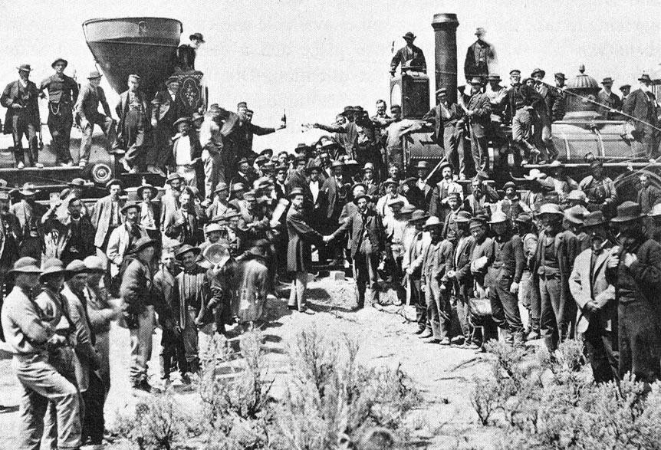
On May 10, 1869, a golden spike was hammered into a track joining the two tracks in Promontory Point, UT.

Slide 19
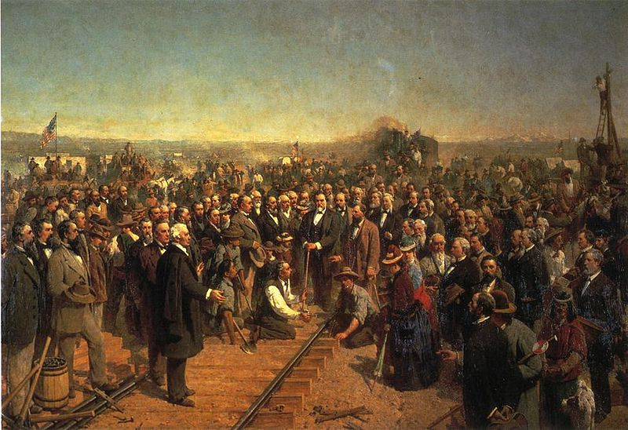
The Driving Of The Last Spike, by Thomas Hill

Slide 20
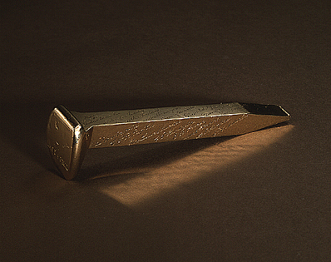
The Last Spike, 1869, located at the Cantor Arts Center at Stanford University

Slide 21
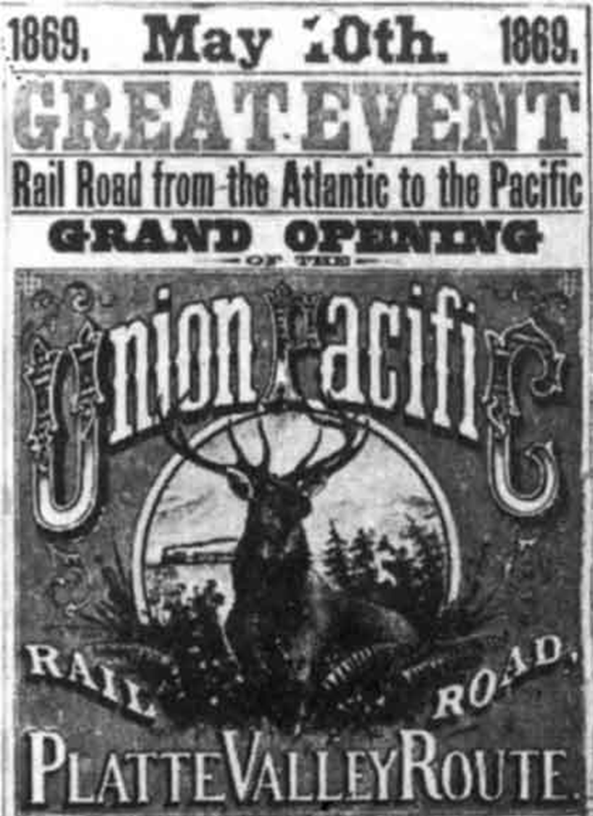
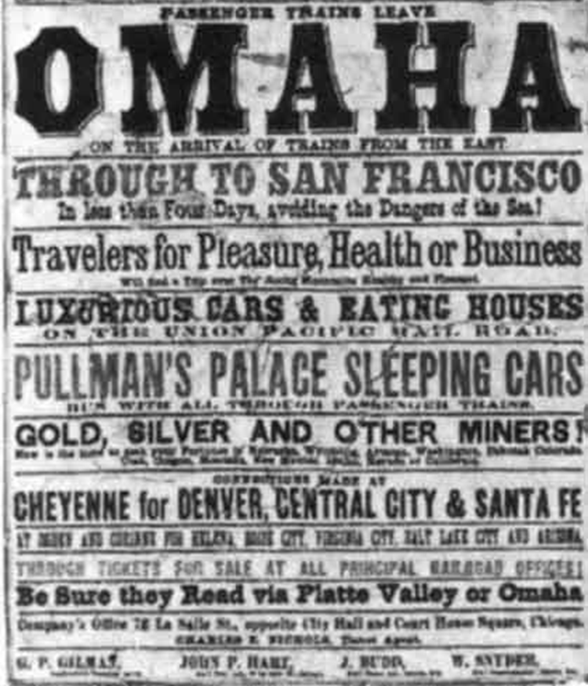
Transcontinental Railroad (3:27)

Slide 22
“At Promontory Point, Utah, on May 10, 1869 – when the rival rails were joined with great fanfare – the Chinese finished the job. But there and elsewhere, Crocker’s Asians were excluded from the festivities. (Charles Crocker was the chief overseer of the Central Pacific Railroad’s works.) At San Francisco’s grand celebration, the keynote speaker attributed the railroad’s existence to ‘the commingled blood of the four greatest nationalities of modern days’ – the French, Germans, English, and Irish of America. And at a centennial observance in 1969, Secretary of Transportation John A. Volpe echoed the sentiment: “Who else but Americans,” he intoned, “could drill ten tunnels in mountains thirty feet deep in snow? Who else but Americans…?”

