Slide 2
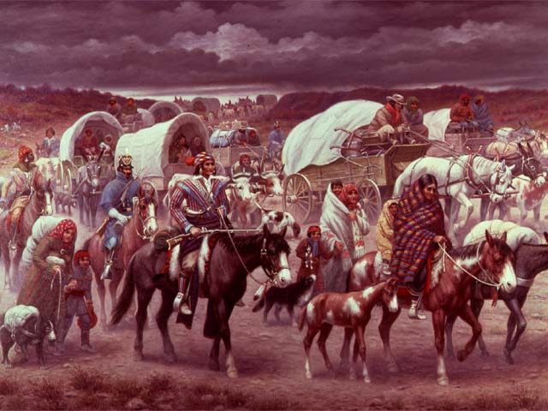

Slide 3
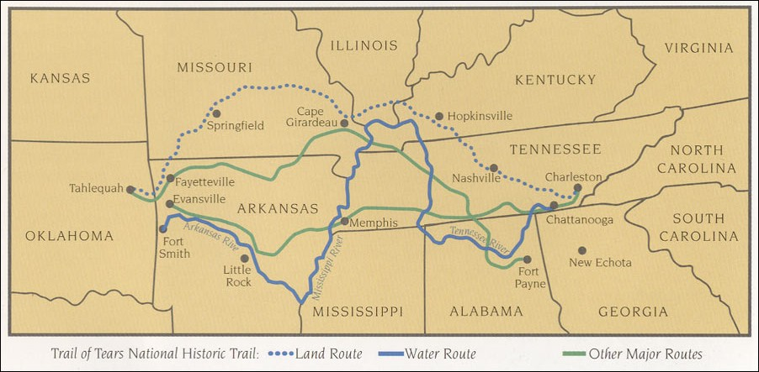

Slide 4
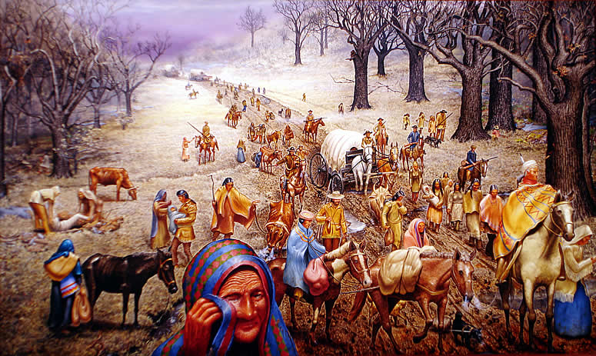

Slide 5
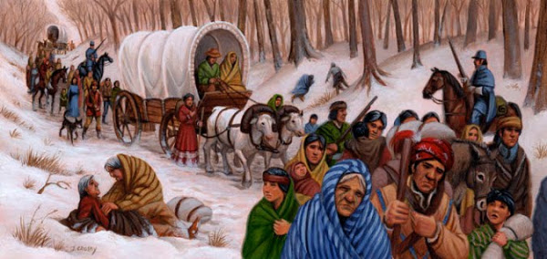

Slide 6
What do you think the artifacts are depicting?
What emotions do you feel about the artifacts or events?

Slide 7
Now read The Neverending Trail
Remember to pay attention to WHO wrote it (and possibly why)
You will be looking for TONE
You will also choose 3 quotes to help understand the poem

Slide 9
Indian Removal Act
The Indian Removal Act was passed by Congress on May 28, 1830, during the presidency of Andrew Jackson. The law authorized the president to negotiate with Indian tribes in the Southern United States for their removal to federal territory west of the Mississippi River in exchange for their ancestral homelands.

Slide 10
Under orders from President Jackson the U.S. Army began enforcement of the Removal Act. The Cherokee were rounded up in the summer of 1838 and loaded onto boats that traveled the Tennessee, Ohio, Mississippi and Arkansas Rivers into Indian Territory. Many were held in prison camps awaiting their fate. Some of the Chickasaw, Creek, Choctaw, & Seminole were also removed.

Slide 11
An estimated 4,000 died from hunger, exposure and disease. The journey became a cultural memory as the "trail where they cried" for the Cherokees and other removed tribes. Today it is widely remembered by the general public as the "Trail of Tears".
So where did we “remove” the tribes to?

Slide 12
So what are the pros and cons of moving west?
Try to make a list of as many pros and cons for moving West.

Slide 13
Thesis Example
Americans moving westward was ___________ because (now list your 2-3 BIG ideas for why).

