Slide 1
Natural Resources

Slide 2
Natural Resource
Natural = existing in nature and not made or caused by people.
Resource = something that a country or place has that can be used to increase wealth
Natural Resource = materials supplied by nature
examples include: plants, animals, minerals and fresh air.

Slide 3
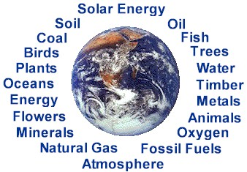
Natural Resource

Slide 4
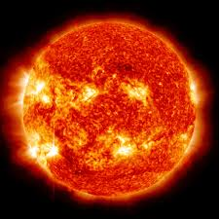
Perpetual Resource
Resources that we have an unlimited amount of
-Solar, tidal, geothermal
& wind energy

Slide 5
Renewable Resource
A resource that keeps coming back and can be used over and over again.
Some examples: biomass, fish, sun.
Are trees renewable? All animals? Water?

Slide 6
Non-renewable Resource
Opposite of renewable resources- resources that we can only use once.
Examples include fossil fuels, coal, oil, & minerals.

Slide 7
Non-renewable VS renewable Resource

Slide 8
Potential Resource
A Resource that we don’t know how to use as a resource yet.

