Slide 1
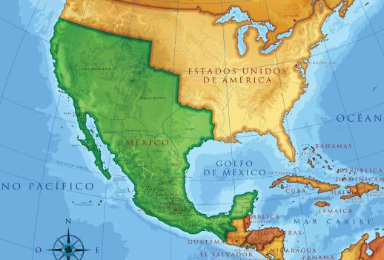
The West: Mexican-American War

Slide 2
The West: Mexican-American War
To demonstrate understanding of the events of the Mexican-American War, fill out the six boxes, with title and visual, for the following slides
Event 1: U.S. ‘annexes’ Texas in March, 1845 | Event 2: Border Dispute leads to war in June, 1845 | Event 3: Bear Flag Revolt in Somoma, CA
1 | 2 | 3
Event 4: General Taylor Drives Santa Anna’s forces deep into Mexico, eventually controlling Mexico City | Event 5: Treaty of Guadalupe Hidalgo (1848) ends the war, giving the U.S. 500,000 square miles of territory | Event 6: Gadsden Purchase allows the U.S. to purchase even more of Mexico’s land in December of 1853
4 | 5 | 6

Slide 3
The West: Mexican-American War
Texas had gained independence from Mexico and was its own country for about ten years (1836-1846). But they were not strong enough to protect their own borders from invaders, so they considered joining the United States.
Event 1

Slide 4
The West: Mexican-American War
Texas leaders, most of whom were former Americans, decided to join the U.S. Texas was ‘annexed’ by the United States in 1845, making it an official state. Many Mexicans believed that the forced signing of a treaty by Santa Anna to give Texas its independence was not valid.
Event 1

Slide 5
Event 1: US “annexes” Texas in March, 1845

Slide 6
The West: Mexican-American War
For years, the results of the Texas Revolution did not resonate well with Mexicans. Within a decade, border disputes arose between the United States and Mexico. The United States claimed the border to be the Rio Grande while Mexico believed the border was at the Nueces River.
Event 2
Nueces River
Rio Grande

Slide 7
Event 2: Border disputes lead to war in June, 1845

Slide 8
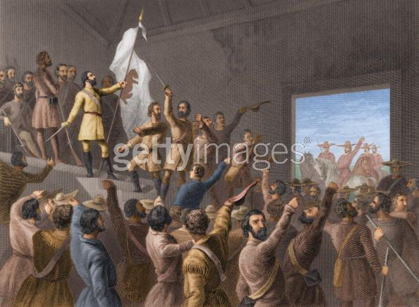
The West: Mexican-American War
Meanwhile, in California, which was Mexican territory, there were Mexicans called Californios (Mexicans in California) and Anglos (Americans in California). Even though there were fewer Americans, they still took over the town of Sonoma near San Francisco & claimed California to be a new nation. This was called the Bear Flag Revolt.
Event 3
Bear Flag Revolt

Slide 9
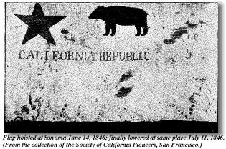
The West: Mexican-American War
The newly declared California Republic was soon taken over by the U.S. army and claimed for the United States at the start of the Mexican-American War. Major cities in California like San Francisco, Los Angeles and San Diego were quickly captured from the Mexican army.
Event 3

Slide 10
Event 3: Bear Flag Revolt in Sonoma, CA

Slide 11
The West: Mexican-American War
A common problem during the Mexican-American War was soldiers deserting the army. The American Army in this war was estimated at 8.3% (9,200 out of 111,000).

Slide 12
The West: Mexican-American War
The Mexican Army had far higher desertion rates. Most Mexican soldiers were peasants who were conscripted by generals to fight. They were underpaid, underfed, undertrained and undersupplied.

Slide 13
The West: Mexican-American War
They were often more loyal to their villages and families than to the generals who forced them to fight. As a result, many soldiers would flee camp the night before a battle or the night before marching long distances.

Slide 14
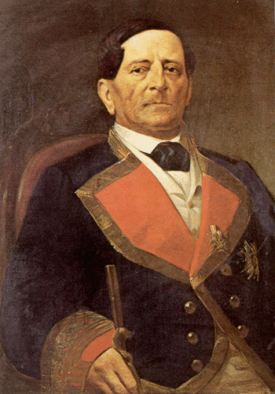
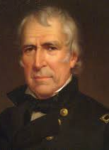
The West: Mexican-American War
General Zachary Taylor, who eventually became a U.S. president, led U.S. forces deep into Mexico. He defeated forces led by Antonio Lopez de Santa Anna, the same general who lost the Battle of San Jacinto to end the Texas Revolution.
Event 4
Antonio Lopez de Santa Anna
Zachary Taylor

Slide 15
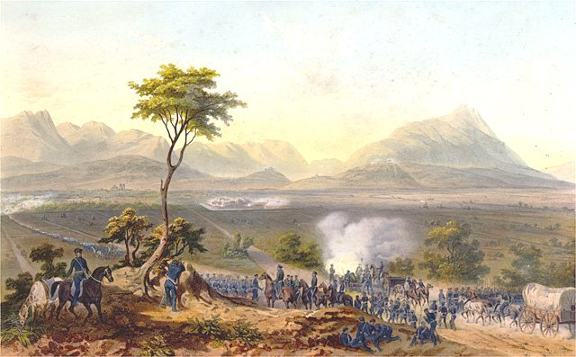
The West: Mexican-American War
U.S. forces soon entered Mexico City. The Mexicans were outnumbered in almost every area. The United States occupied many of Mexico’s largest cities and Mexico could not defend itself. Mexico was also dealing with internal divisions, including a domestic uprising in the Yucatan.
Event 4

Slide 16
Event 4: General Taylor Drives Santa Anna’s forces deep into Mexico, eventually controlling Mexico City

Slide 17
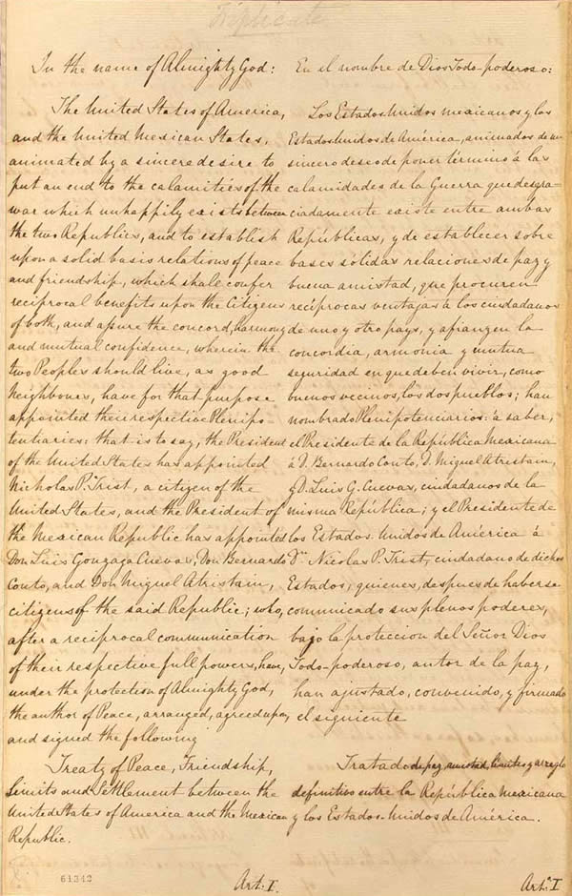
The West: Mexican-American War
The TREATY OF GUADALUPE HIDALGO was signed in February 1848. It was 500,000 miles in all, giving the United States 25% more land. The United States also paid Mexico 15 million dollars as part of the agreement.
Event 5

Slide 18
The West: Mexican-American War
The Treaty of Guadalupe Hidalgo gave the United States:
All of California, Nevada & Utah
Most of Arizona & New Mexico
Parts of Colorado & Wyoming
Event 5

Slide 19
Event 5: Treaty of Guadalupe Hidalgo (1848) ends the war, giving the U.S. 500,000 square miles of territory

Slide 20
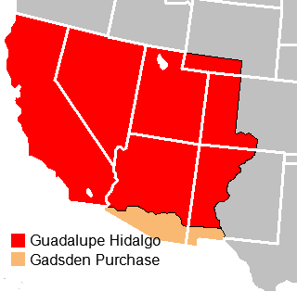
The West: Mexican-American War
About 6 years after the Treaty of Guadalupe Hidalgo, the United States bought another section of land from Mexico in the Gadsden Purchase of 1854. This was primarily for the purpose of building a railroad, but plans were put on hold because of the Civil War, which broke out 7 years later.
Event 6

Slide 21
Event 6: Gadsden Purchase allows the U.S. to purchase even more of Mexico’s land in December of 1853

Slide 22
Some review time!

