Slide 1
World Cultures

Slide 2
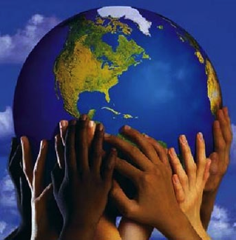
What is Culture?
Customary ways in which humans live
All the features of a people’s way of life
Characteristics of a particular group

Slide 3
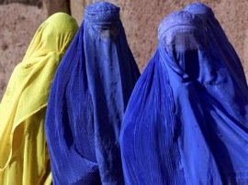
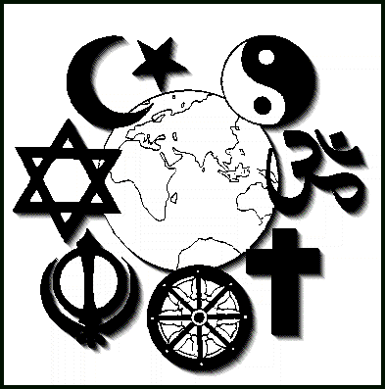
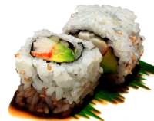
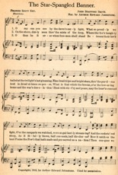
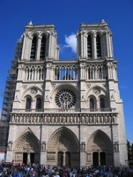
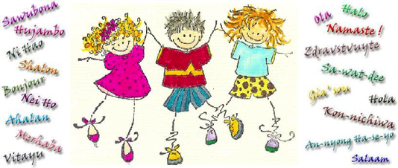
Everyone has a culture! Culture Traits are symbols of the culture
Food
Clothing
Religion
Art
Music
Language
Beliefs
Values
Education
Family
Housing
Government
Economy
Social Groups

Slide 4
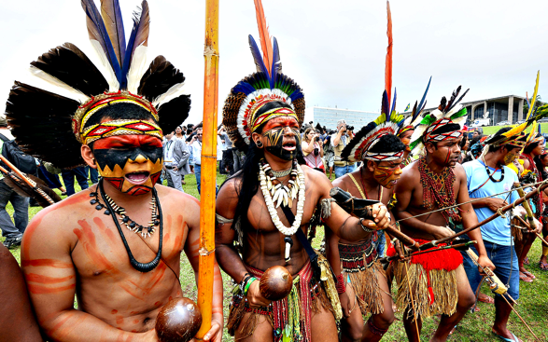
Ethnic Group
Socially defined group
Community of people who share a common cultural background
Examples: (these are some groups people May identify as)
German – where your from
Indigenous Groups – aboriginals in Australia
Hispanic
Huns vs. mongols
(mulan)
Caucasian

Slide 5
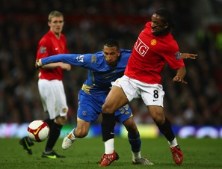
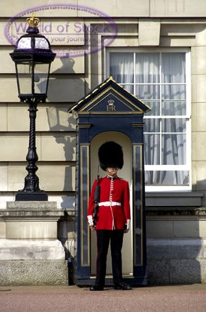
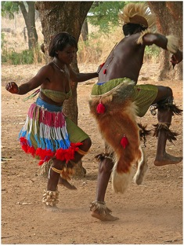
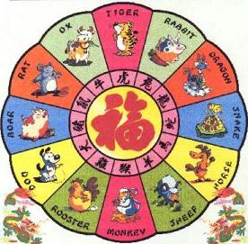
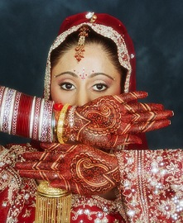
Symbols of Culture

Slide 6
What is a Region?
Identifies areas with shared characteristics
Can be based on physical, cultural, economic characteristics or a combination of these characteristics
Can be vague, overlap and/or exclude areas

Slide 7
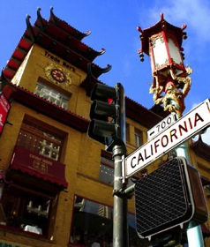
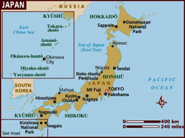
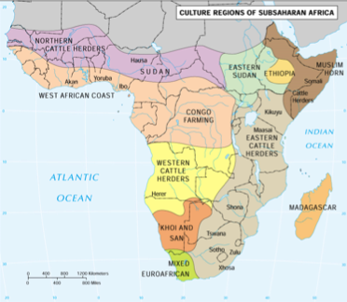
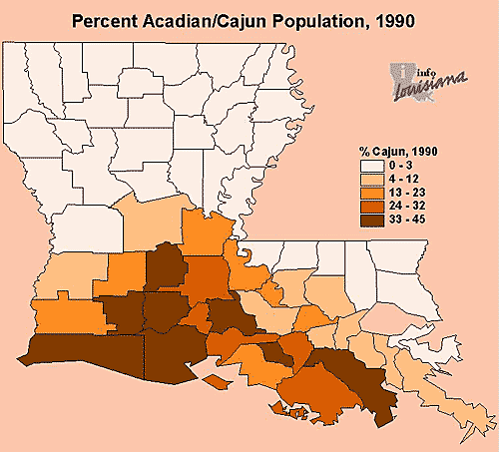
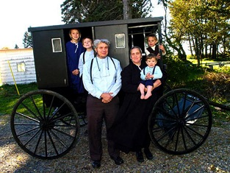
Culture Regions
Area Where one culture is dominant
Chinatown
Cajun Louisiana
Amish--Pennsylvania

Slide 8
Take a look around the room
Choose one person in the room and describe them in a way that a person who has never spoken to or interacted with will be able to pick them out in this room.

Slide 9
Racism?
Since we are talking about culture and ethnic groups lets take a minute to talk about Racism.
What is Racism?
the belief that all members of each race possess characteristics or abilities specific to that race, especially so as to distinguish it as inferior or superior to another race or races.
Is racism always “rude”?

