Slide 1
USA
Soviet Union

Slide 2
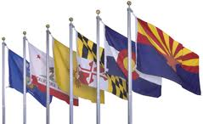
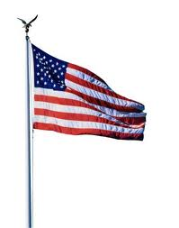
The Cold War
The United Nations Formed
48 countries join plan for peace and security
1945
1950
1955
The Yalta Conference
The “Big 3” meet
Plan the division of Europe

Slide 3
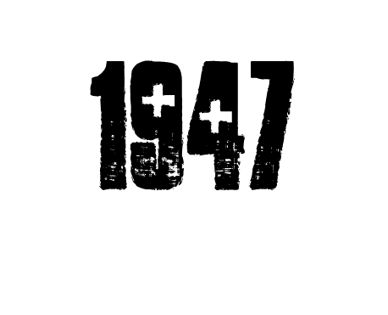
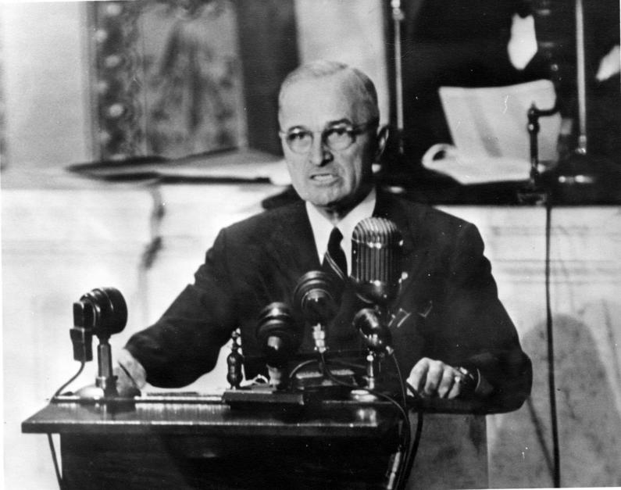
The Truman Doctrine
US will aid any country fighting communism
-containment policy: stop spreading communism
So... what is communism?
Complete page 11 now!

Slide 4
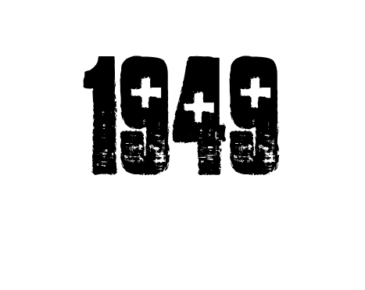
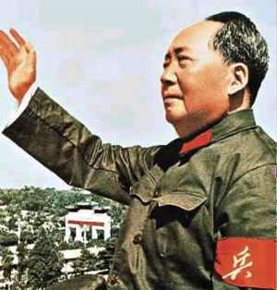
China Becomes Communist
Mao Zedong takes power
Nationalists flee to Taiwan

Slide 5
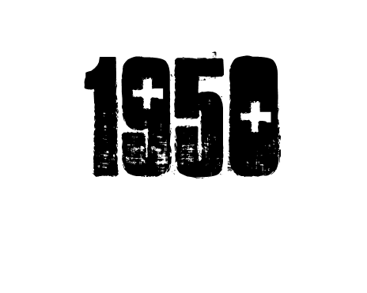
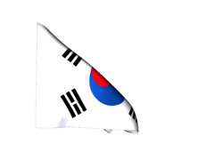
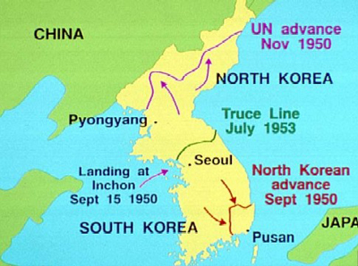
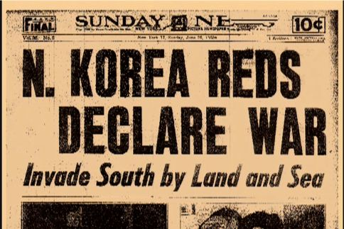
Korean War Begins
North Korean troops cross 38th Parallel
US enters to contain communism

Slide 6
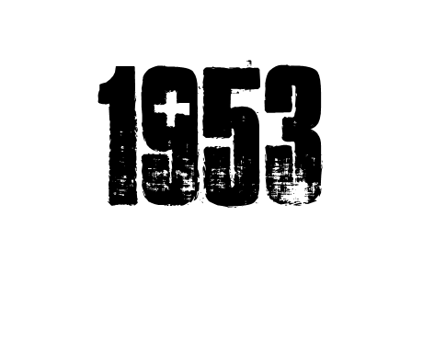
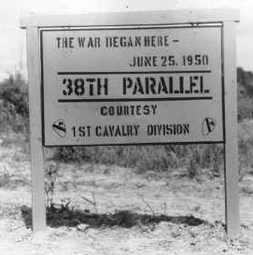
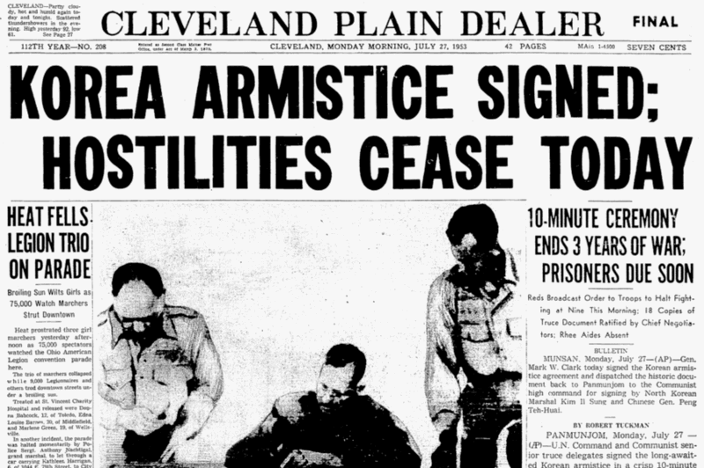
Korean War Ends
in stalemate (tie) at 38th Parallel

Slide 7
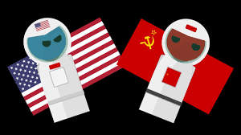
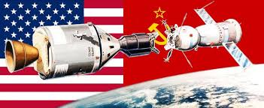
The Space Race Begins
1959
Complete page 12
In your packet now

Slide 8
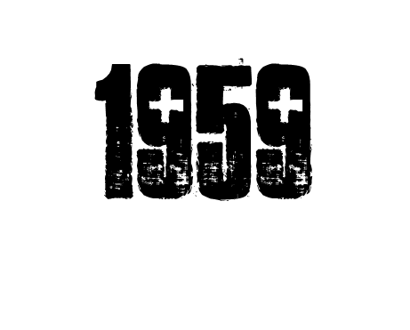
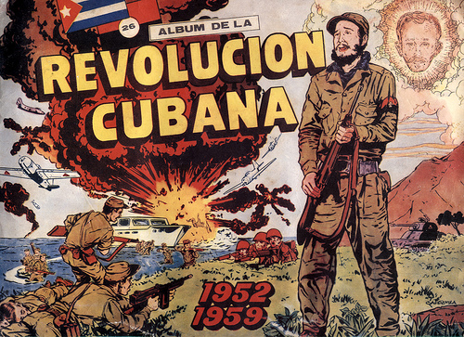
Cuba Becomes Communist
Fidel Castro takes power

Slide 9
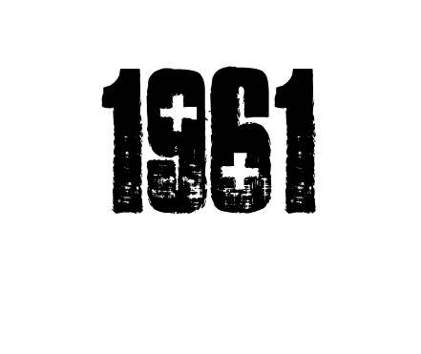
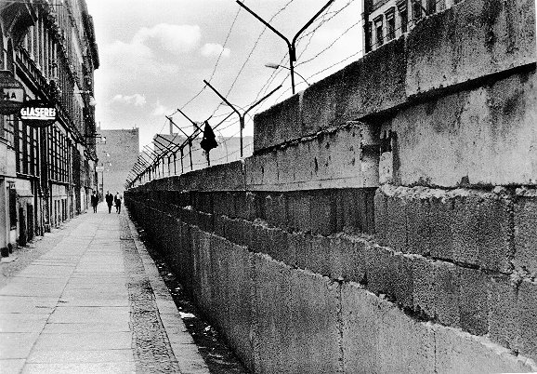
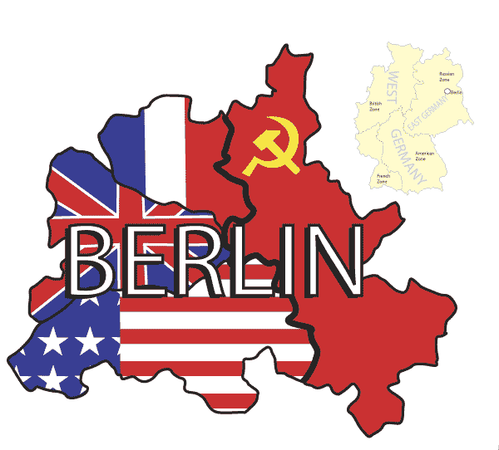
Berlin Wall Built
Divides Berlin in half - Communist & Democratic

Slide 10
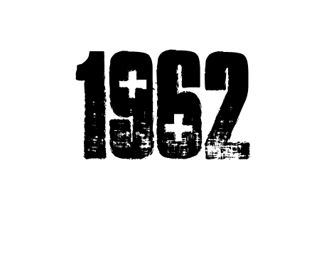
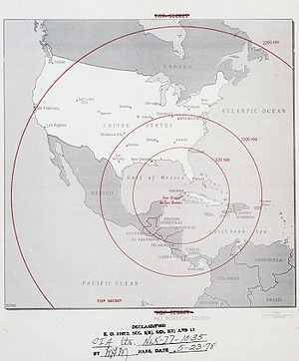
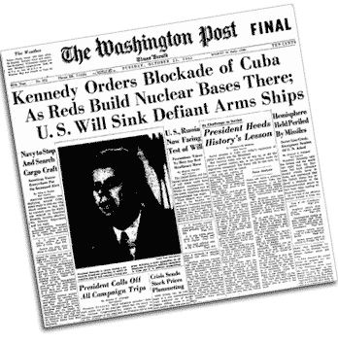
Cuban Missile Crisis
Soviets place Nuclear missiles in Cuba
President Kennedy orders them removed

Slide 11
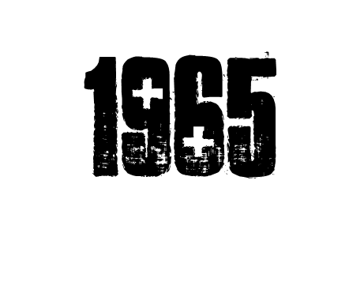
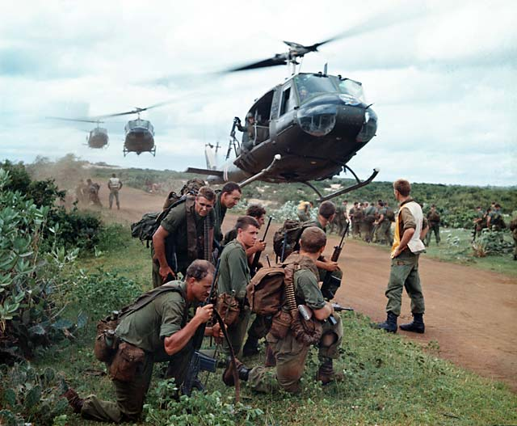
US Enters Vietnam War
Communist North at war with Democratic South
US troops sent to contain communism

Slide 12
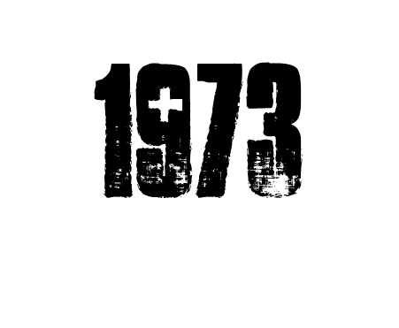
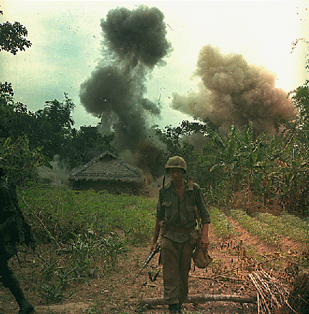
US Leaves Vietnam
Ends in a stalemate
Vietnam reunited Communist 2 years later

Slide 13
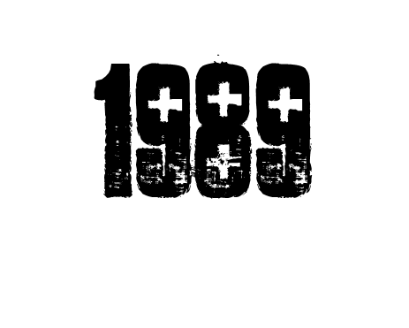
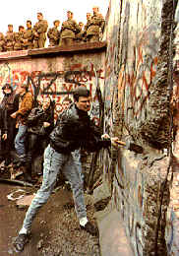
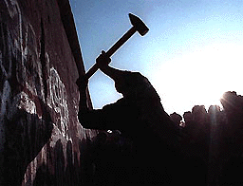
Berlin Wall torn down
Soviets fail to stop Berliners tear down the wall Germany reunified under democratic rule

Slide 14
So why was the
“cold”?
Tension between the US and Soviet Union but NO actual fighting
USA
Soviet Union

