Slide 1
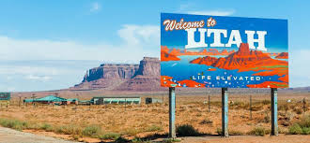
Why do businesses come to Utah?

Slide 2
Why do we need businesses in Utah?
We need services- such as dry cleaning, hotels, plumbers
We need goods- such as food, clothing, computers
We need jobs- people need income to pay for necessities

Slide 3
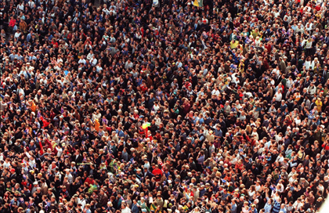
So, why do business come to Utah?
Growing, Healthy Workforce
High birth rate
(our population grows twice the national average)
Utah is ranked high in overall health

Slide 4
So, why do business come to Utah?
2. Focus on Education
12 universities and colleges
Lots of graduates
Utah leads the nation for money spent on research and higher education

Slide 5
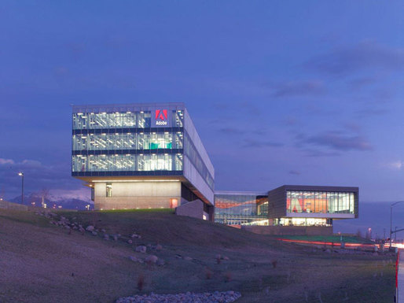
So, why do business come to Utah?
3. Tech Savvy
Technology companies very successful in Utah
Most families have computers/internet at home

Slide 6
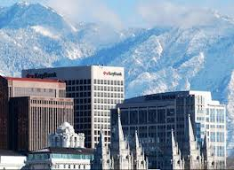
So, why do business come to Utah?
4. Affordable
Cost of doing business is lower here than other major technology cities
Lower costs for leasing buildings/land
Government rewards companies

Slide 7
So, why do business come to Utah?
5. Living Conditions
Great transportation system
Great medical care
Safe communities
Natural beauty
Easy access to recreation/nature

Slide 8
What do you think?
1. Do you think Utah is a great place to live? Why or Why not? (2-3 sentences)
2. Do you think Utah is a great place to do business? Why or Why not? (2-3 sentences)

